Slide 1
N-BEATS: Time-Series Forecasting with Neural Basis Expansion
Boris N. Oreshkin, Dmitri Carpov, Nicolas Chapados, Yoshua Bengio
International Conference on Learning Representations, 2020
Presented by Group 8
Madhav Bajaj
Aditya Agarwal

Slide 2



Introduction
Time-series forecasting underpins essential aspects of modern business across numerous sectors.
Even minute improvement in forecasting accuracy can result in tremendous gains¹
Finance
Manufacturing
Energy
Forecasting is ubiquitous in the financial industry. Modeling of price and volatility of market variables used as a measure of risk is well ingrained in industry practices.
According to a study², every 1% percent improvement in forecasting errors can result in savings of around $3.52 million for an average consumer products company.
Electricity price forecasts have become a fundamental input to energy companies’ decision-making and risk management mechanisms.^{3,4}
K. B. Kahn, How to Measure the Impact of a Forecast Error on an Enterprise?, The Journal of Business Forecasting Methods & Systems, 22(1), 2003
C. L. Jain, Answers to your forecasting questions, Journal of Business Forecasting, 36, 2017
A. Eydeland, K. Wolyniec, Energy and power risk management, Wiley, 2003
D.W. Bunn (Ed.), Modelling prices in competitive electricity markets, Wiley, 2004

Slide 3
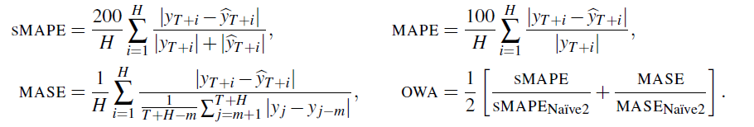
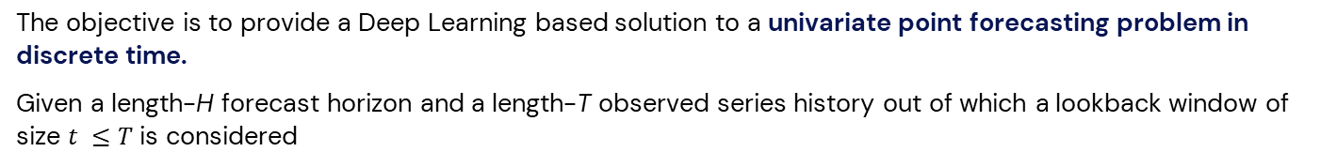
Problem Statement
The objective is to provide a Deep Learning based solution to a univariate point forecasting problem in discrete time.
Given a length-H forecast horizon and a length-T observed series history out of which a lookback window of size $t ≤T$ is considered
$$x ∈ ℝ^{t}=\left[y_{T−t+1} , … , y_{T}\right]$$
The task is to predict the vector of future values
$$y ∈ ℝ^{H}=[y_{T+1},… , y_{T+H}]$$
Let $\hat{y}$denote the forecast of $y$, then the following metrics will be used to evaluate the performance of the model
MAPE (Mean Absolute Percentage Errors), sMAPE (Symmetric MAPE), MASE (Mean Absolute Scaled Error), OWA (overall weighted average).
m is the periodicity of data
Naïve predictor simply copies the observation measured m periods in the past

Slide 4
State-of-the-Art
For the longest time, studies¹ provided evidence that pure ML models are inferior to the classical approaches on univariate TS forecasting tasks. It was only recently that the domain witnessed a paradigm shift towards ML-based models.
In the last few years, the combination of ML and statistical approaches have shown promising results by using the outputs of statistical engines as features.
The winner of the 4th edition of the premier platform for forecasting methodologies, the Makridakis M4 competition is the ES-RNN², a hybrid LSTM & Exponential Smoothing model developed by Uber.
The second-best entry in the M4 competition (FFORMA³) utilized a meta-learning-based approach over a pool of statistical models.
In the recently concluded M5 competition, all 50 top-performing models were based on ML. The top 5 entries employed various weighted combinations of LightGBM models.
 | Model | Mean sMAPE | Mean MASE
ML Models | MLP Iterative | 12.29 | 0.96
 | MLP Direct | 13.49 | 1.08
 | MLP Multi | 12.77 | 1.01
 | BNN Iterative | 12.09 | 0.93
 | BNN Multi | 12.71 | 1.01
Statistical Models | Naïve | 12.77 | 1.05
 | SES | 11.26 | 0.97
 | Holt | 11.51 | 0.94
 | Damped | 11.02 | 0.92
 | Comb | 10.97 | 0.91
 | Theta | 10.89 | 0.9
 | ARIMA | 11.28 | 0.89
 | ETS | 11.26 | 0.92
Source: ¹S. Makridakis (2018)
Lower Metric values are better
S. Makridakis et al, Statistical and Machine Learning forecasting methods: Concerns and ways forward, 2018
S. Smyl A hybrid method of exponential smoothing and recurrent neural networks for time series forecasting, International Journal of Forecasting, 2020
P. M. Manso et al., FFORMA: Feature-based forecast model averaging, International Journal of Forecasting, 2020

Slide 5
Contributions
This research makes two primary contributions:
Superiority of ML models
The N-BEATS model is the first work to empirically demonstrate that pure DL using no time-series specific components outperforms well-established statistical approaches. The model provided a proof of concept for the use of pure ML in time-series forecasting and has strengthened the motivation of academia to continue advancing research in the domain.
Interpretability
Interpretability in machine learning can essentially be defined as the degree to which a human can understand the cause of a decision made by the model. Model Interpretability of Deep Neural Networks (DNNs) has always been a limiting factor for use cases requiring explanations of the features involved in modeling, and such is the case for many industries, such as Financial Services. This research also shows that it is feasible to design a DNN architecture with interpretable outputs for forecasting.

Slide 6
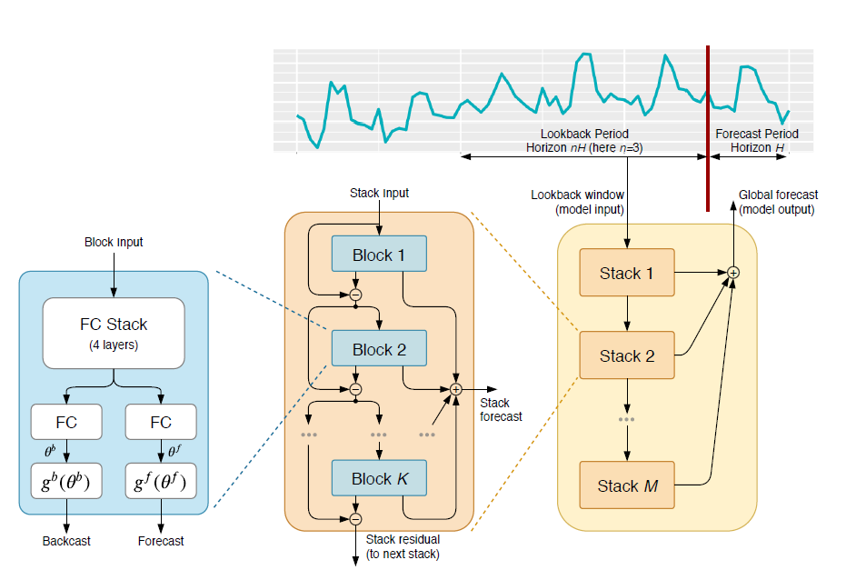








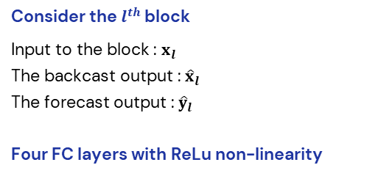
Proposed Model
Consider the $l^{th}$ block
Input to the block : $x_{l}$
The backcast output : ${\hat{x}}_{l}$
The forecast output : ${\hat{y}}_{l}$
Four FC layers with ReLu non-linearity
Linear Projection Layer
and are forward and backward expansion coefficients
Basis Layer
The basic block

Slide 7





Proposed Model
Double Residual Stacking
Basis Layer
Here, $v_{i}^{f}$ and $v_{i}^{b}$ are forecast and backcast basis vectors
Selection of and which provide sets and
provides two architectures
Generic Architecture
No reliance on time-series domain knowledge and not interpretable
Interpretable Architecture
Introduce trend and seasonality decomposition into the model to make the model outputs more easily interpretable

Slide 8








Proposed Model
Interpretable Architecture
Introducing subscript s in the notation for variables to denote the stack index
Trend Model
Seasonality Model
Constraining and to be a polynomial of small degree p to mimic trend.
Constraining and to belong to a class of periodic functions to mimic seasonality.
Alternatively
Alternatively

Slide 9
Dataset Description
M4¹ competition provided a large and diverse 100k-series dataset consisting of data frequently encountered in business, financial and economic forecasting and sampling frequencies ranging from hourly to yearly.
M3² is similar in its composition to M4 but has a smaller overall scale (3003 time series total vs. 100k in M4). Over the past 20 years, this dataset has supported significant efforts in the design of more optimal statistical models. Furthermore, a study by Makridakis (2018) substantiating the inferiority of pure ML models is based on a subset of M3.
TOURISM³ dataset was released as part of the respective Kaggle competition conducted by Athanasopoulos & Hyndman (2011). The data include monthly, quarterly, and yearly series supplied by governmental tourism organizations (e.g., Tourism Australia, the Hong Kong Tourism Board, and Tourism New Zealand) and various academics who had used them in previous studies.
S. Madridakis et al., The M4 Competition: 100,000 time series and 61 forecasting methods, International Journal of Forecasting, 2020
S. Madridakis, M. Hibbon, The M3-Competition: results, conclusions and implications, International Journal of Forecasting, 2000
Athanasopoulos et al., The tourism forecasting competition, 2011

Slide 10
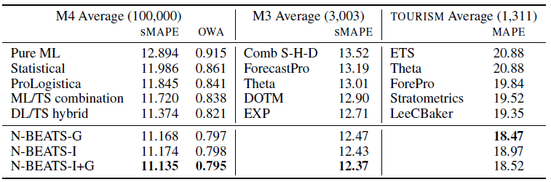
Results
Lower values better
G refers to Generic, I refers to Interpretable
N-BEATS has performed remarkably well against the SOTA models.
N-BEATS registered a 3% improvement over the DL/TS Hybrid model ES-RNN, the winner of the M4 competition.

Slide 11
Future Work
Extension to Multivariate Forecasting
Extension to Distributive Forecasting
Analysis and empirical exploration of the meta-learning effects associated with the architecture.

Slide 12
Thank You!

